Slide 1

TO LET 7 ha (17.32 acres)
HARD STANDING SURFACED YARD
COBLANDS NURSERIES, TRENCH ROAD, TONBRIDGE, KENT, TN11 9NG

Slide 2
LOCATION
Coblands Nurseries is situated to the North of Tonbridge. It is accessed off Trench Road which lead to the A227 Shipbourne Road. The A25 and M26/M20 are approximately five miles to the North. Tonbridge town centre is approximately 1.5 miles to the South. The A21 is around 2.5 miles to the south.
DESCRIPTION
A har-standing yard located within a secure site. The space is ideal for storage or operational use, with gated access and a hard-standing surface. Conveniently positioned off trench road.
FLOOR AREA
The yard is available in its entirety
7 ha (17.32 acres)
PLANNING
Interested parties advised to check that their intended use is lawful with the LPA.
TERMS
The site is available to be let by way of a new effective full repairing and insuring lease, outside the Landlord and Tenant Act 1954. For a term of 2 years, subject to a 6 months rolling break thereafter (landlord-only).
RENT
Rent on application. VAT is payable.
BUSINESS RATES
TBC
DEPOSIT
The ingoing Tenant will be required to provide a deposit.
SERVICE CHARGE
The Tenant is to be responsible for a proportion of the estates service charge and insurance (amount TBC).
POSSESSION
Upon completion of legal formalities.
LEGAL COSTS
Each party to be responsible for their own legal costs.
VIEWINGS
Strictly by appointment through sole agents Bracketts:
Telephone: 01732 350503
Dominic Tomlinson
dominic.tomlinson@bracketts.co.uk
Joshua O’Brien
Joshua.o’brien@bracketts.co.uk
Subject to contract
Important Notice
Bracketts, their clients and any joint agents give notice that they have no authority to make or give any representations or warranties in relation to the property. These particulars do not form part of any offer or contract and must not be relied upon as statements or representations of fact. The text, photographs and plans are for guidance only and are not necessarily comprehensive. Any areas, measurements or distances are approximate. It should not be assumed that the property has necessary planning, building regulation or other consents and Bracketts have not tested any services equipment or facilities. Purchasers must satisfy themselves by inspection or otherwise. Prices, rents or any other charges are exclusive of VAT unless stated to the contrary.

Slide 3
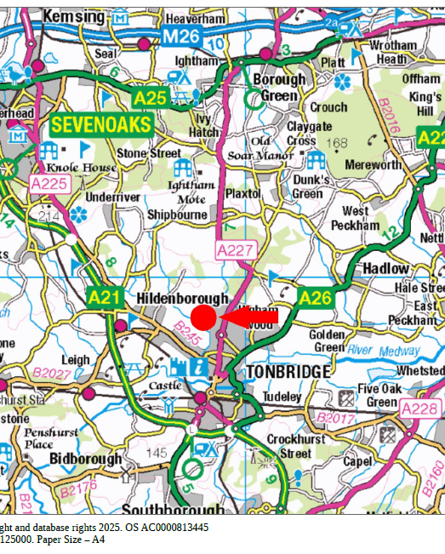

Slide 4


TO LET
SECURE SURFACED YARD
APPROX. 7 ha (17.32 acres)
COBLANDS NURSERIES
TRENCH ROAD
TONBRIDGE
KENT
TN11 9NG
FURTHER INFORMATION & VIEWINGS
For further information or to arrange an inspection, please contact sole selling agents BRACKETTS
01732 350 503
Dominic Tomlinson
dominic.tomlinson@bracketts.co.uk
Joshua O’Brien
joshua.o’brien@bracketts.co.uk

