Slide 1
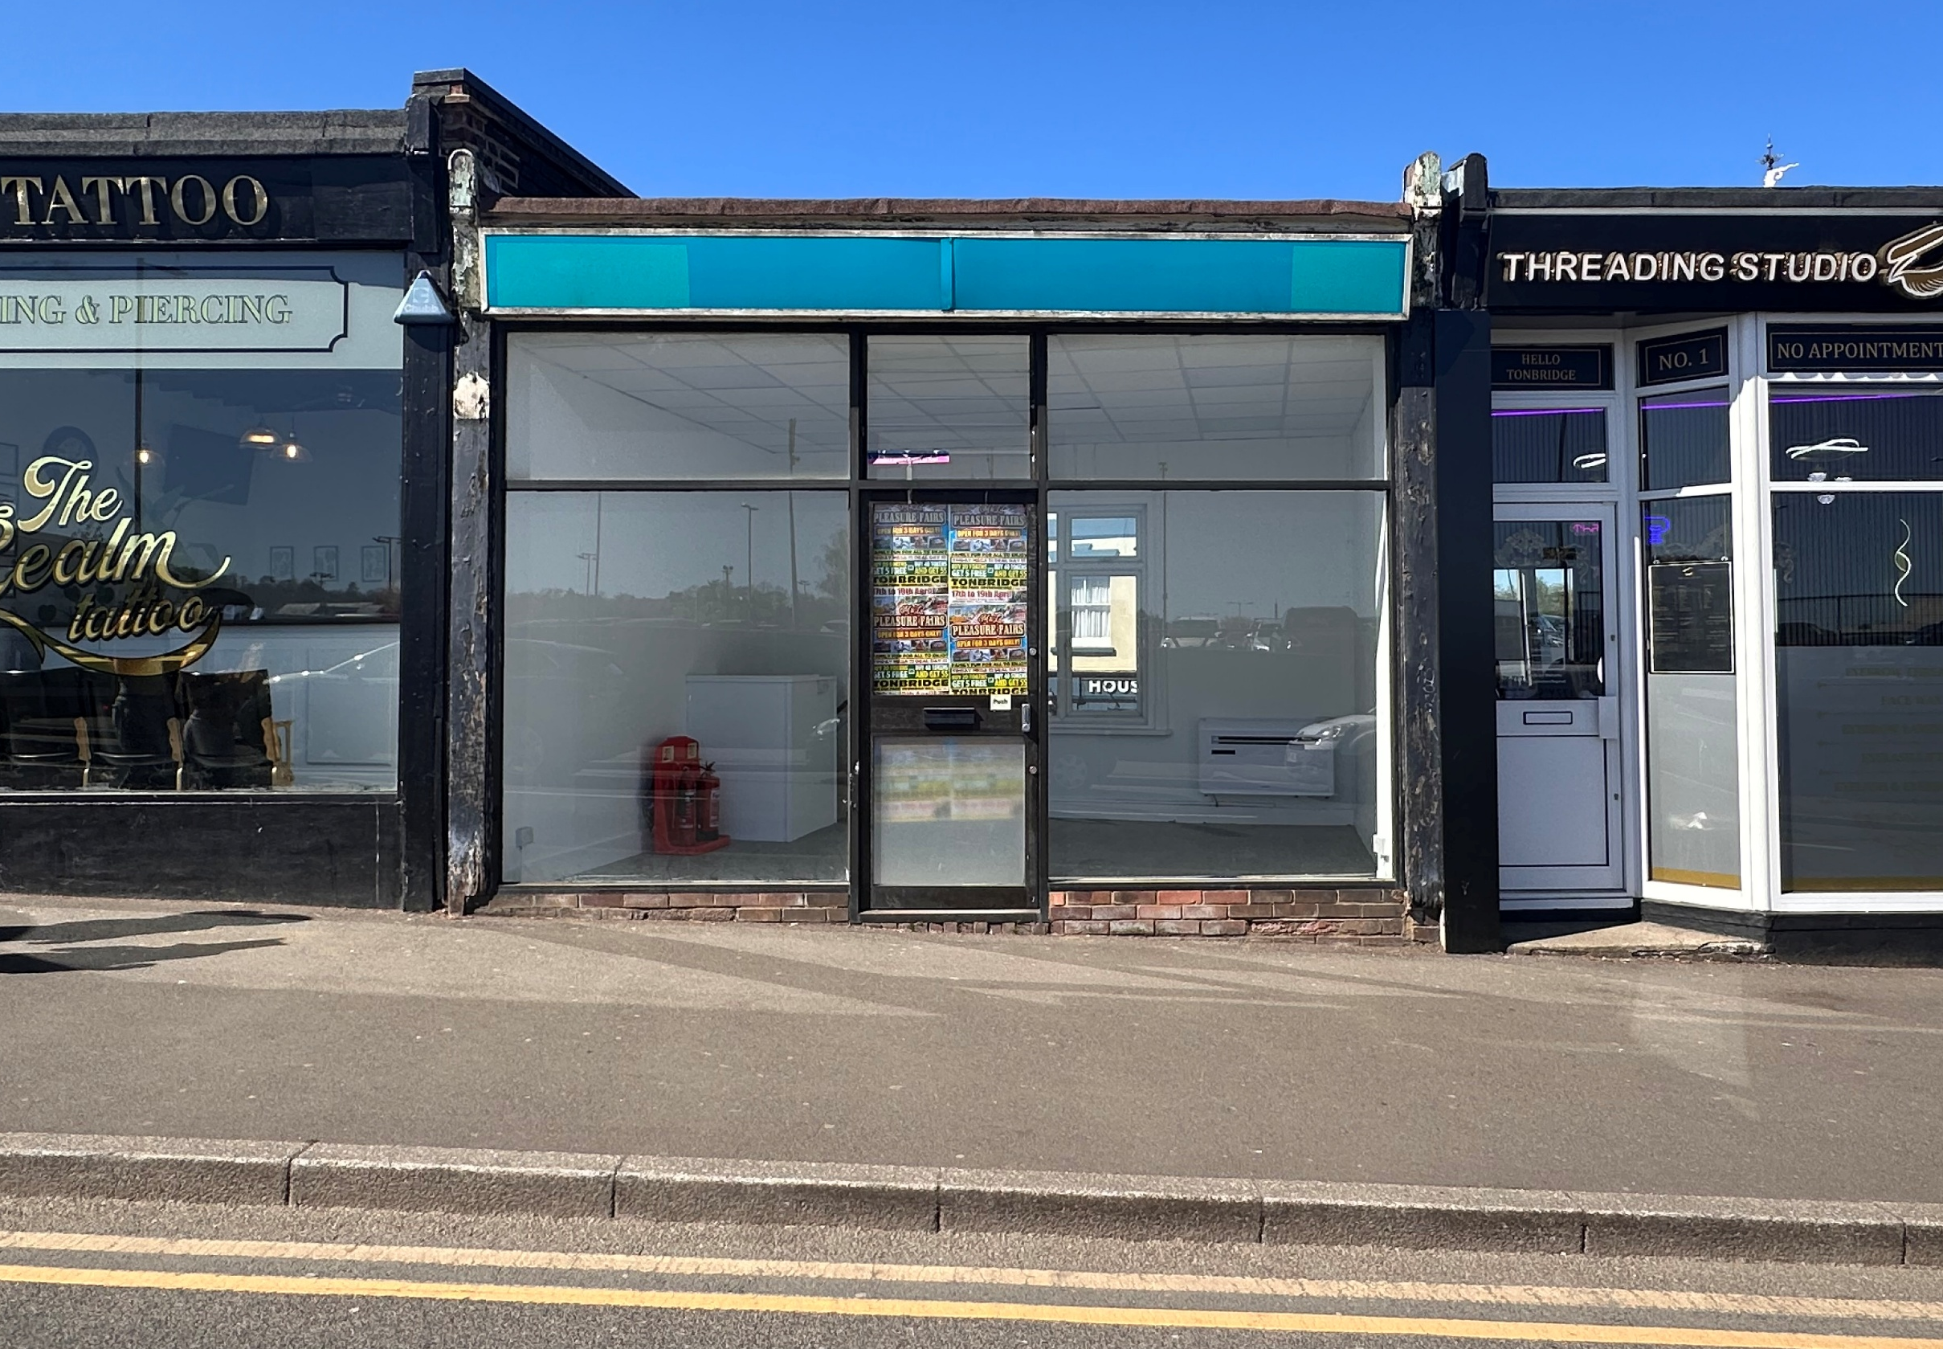

TO LET 34 SQ M (370 SQ FT)
CLASS E RETAIL UNIT
2 Railway Approach, Tonbridge, TN9 2RQ

Slide 2
LOCATION
Railway Approach is situated directly between Tonbridge Mainline Station and the town’s commercial area.
The parade is within 50 metres of Tonbridge Mainline Station, which provides a fast and frequent train service to central London stations, with a maximum journey time of around 35 minutes.
DESCRIPTION
Access to the front is via Railway Approach with access to the lower ground floor via Barden Road. The full parade comprises 8 mixed-use
units. Surrounding occupiers include Lidl, Ladbrooks, Pizza GoGo, and Railway Groceries.
FLOOR AREA
The unit has the following approx. floor area:
34 SQ M (370 SQ FT)
PLANNING
We are informed that the property can be used for CLASS E planning uses.
Interested parties are advised to make their own enquiries to ensure their use is lawful.
TERMS
Available on The Arch Company’s Standard
Tenancy Agreement typically 3 or 6 years subject to negotiation. Other lease terms available.
All agreements will be granted outside Sections 24-28 of the Landlord and Tenant Act 1954 Part II.
RENT
£18,000 per annum exclusive, payable quarterly in advance.
VAT
VAT is payable.
SERVICE CHARGE
To be confirmed
BUSINESS RATES
Enquiries from the VOA Website indicate that the property is described as ‘Shop and premises’ with a rateable value of £7,900.
POSSESSION
Upon completion of legal formalities.
LEGAL COSTS
Each party to be responsible for their own legal costs. In the event a Tenant decides not to use a solicitor, a fee of £395 plus VAT will be payable for a Standard Tenancy. Should prospective tenants wish to alter a premises, a License To Alter fee of £350 plus VAT will be payable.
VIEWING
Strictly by appointment through sole agents Bracketts:
Telephone: 01732 350503
Josh O’Brien
josh.o’brien@bracketts.co.uk
Dominic Tomlinson
dominic.tomlinson@bracketts.co.uk
Subject to contract
Important Notice
Bracketts, their clients and any joint agents give notice that they have no authority to make or give any representations or warranties in relation to the property. These particulars do not form part of any offer or contract and must not be relied upon as statements or representations of fact. The text, photographs and plans are for guidance only and are not necessarily comprehensive. Any areas, measurements or distances are approximate. It should not be assumed that the property has necessary planning, building regulation or other consents and Bracketts have not tested any services equipment or facilities. Purchasers must satisfy themselves by inspection or otherwise. Prices, rents or any other charges are exclusive of VAT unless stated to the contrary.

Slide 3
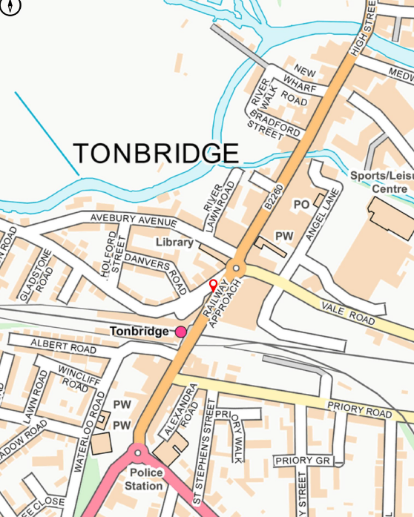

Slide 4
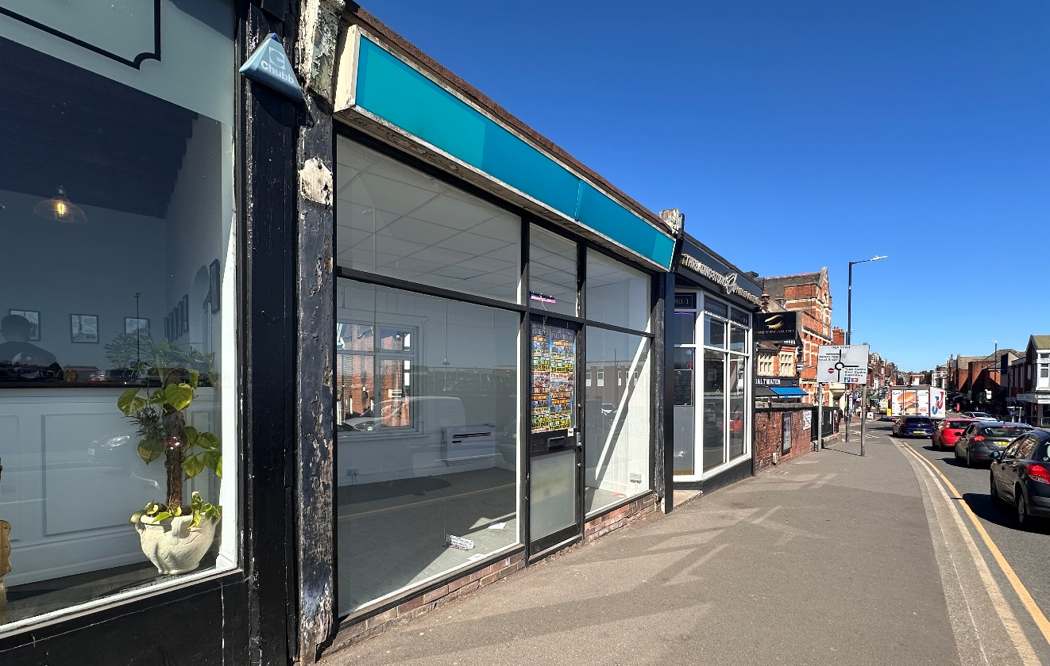
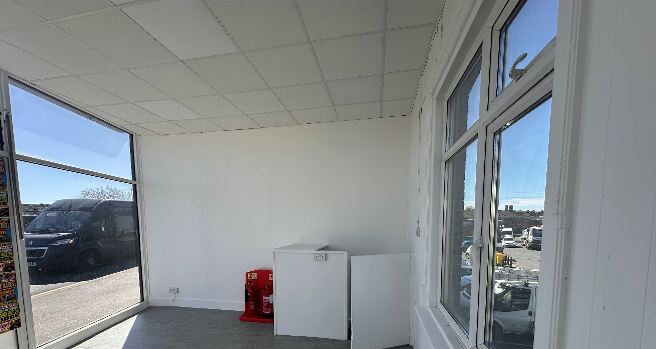

TO LET
CLASS E RETAIL UNIT
34 SQ M (370 SQ FT)
2 Railway Approach
Tonbridge
TN9 2RQ
132 High Street
Tonbridge
Kent TN9 1BB
Tel: (01732) 350503
E-mail: info@bracketts.co.uk
www.bracketts.co.uk
Also at 27-29 High Street,
Tunbridge Wells, Kent
Tel: (01892) 533733

